Slide 1


FACIAL EMOTION RECOGNITION USING ML ALGORITHMS
Date: 13 May 2021
V.V.S.S.RAMYA :17WH1A0501
SK.AFIFARESHMA : 17WH1A0535
AFRAH SAMREEN : 17WH1A0526
Internal Guide: Mr. U.CHANDRASEKHAR
Designation: Associate Professor
Department of Computer Science & Engineering
BVRIT HYDERABAD College of Engineering for Women

Slide 2
Abstract
Why Should I Study this course?
PROJECT OVERVIEW : Facial expression for emotion detection has always been a challenging task in achieving through computer algorithms. In the field of Artificial Intelligence, Facial Emotion Recognition (FER) is an active research area, with several recent studies. With the recent advancement in computer vision and machine learning, it is possible to detect emotion from images. In this project we propose a technique called facial emotion recognition using convolutional neural networks.
Examples
BVRIT HYDERABAD College of Engineering for Women

Slide 3
Block Diagram
Data Acquisition
Data Preprocessing
Model Creation
Output
Classification
Input image
Training and
Accuracy

Slide 4

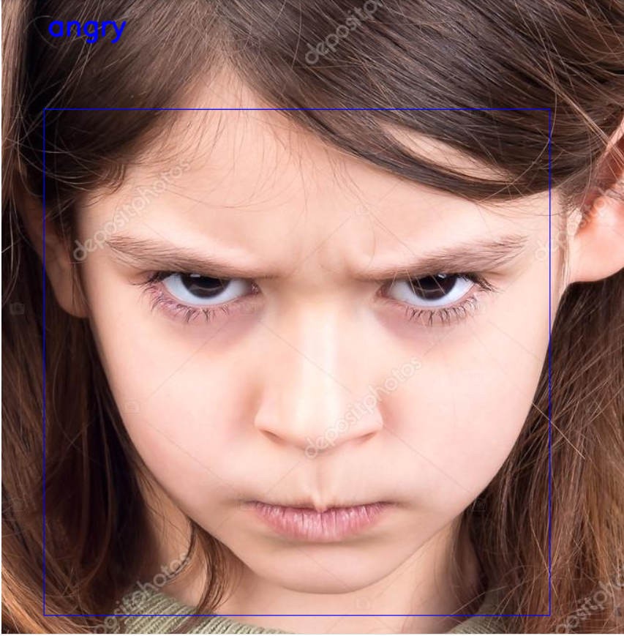

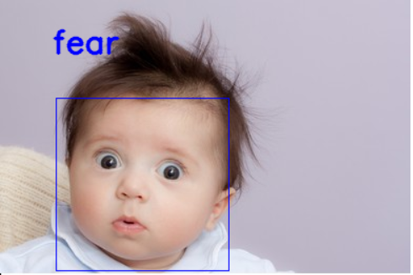
Output
BVRIT HYDERABAD College of Engineering for Women

Slide 5
Thank you
BVRIT HYDERABAD College of Engineering for Women

